Slide 1
Electronic Nicotine Delivery Systems and Vaping Marijuana
Heidi Driscoll, Coordinator, South Kingstown Partnership for Prevention
David Neill, Investigator, United States Attorney’s Office

Slide 2
Electronic Cigarette use among young people has officially surpassed traditional cigarette use!
CDC 2011-2014 National Youth Tobacco Surveys

Slide 3
1 in 7 high school students have tried “VAPING”
Yale University Study

Slide 5
High School 30 Day Use of E-Cigarettes
2011 - 1.5%
2013- 4.5%
2014 - 13.4%
CDC Office of Smoking and Health, July 2015

Slide 6
Middle Schoolers- 30 Day Use 0.6% in 2011 1.1% in 2013 3.9 % in 2014

Slide 7
Nearly 2.5 Million U.S. middle and high school students were past 30 day e-cigarette users in 2014
(CDC Office on Smoking and Health, July 2015: )
More than 263,000 middle and high school students who had never smoked cigarettes had tried e-cigs

Slide 8
NIDA March 2016

Slide 9
PREVENTION WORKS!!
Tobacco Use is at its lowest rate
(among 12-17)
In 2 DECADES
2015 Monitoring the Future Survey (funded by NIDA)

Slide 11
E-Cigs
have arrived in
the life of the American
Teen
The Road to Wellness
CADCA

Slide 12
Rhode Island Law
THE SALE OF CIGARETTES, TOBACCO AND ELECTRONIC NICOTINE-DELIVERY SYSTEM PRODUCTS TO PERSONS UNDER THE AGE OF 18 IS AGAINST RHODE ISLAND LAW (§ 11-9-13.8(1), Rhode Island Statutes) PHOTO ID FOR PROOF OF AGE IS REQUIRED FOR PURCHASE.

Slide 13
E-Cig History
Developed in 2003 in Beijing, China by a pharmacist named Hon Lik
2006-2007 Introduced in US
2009 The Electronic Cigarette Association (ECA) is formed
2010 AMA urges FDA to regulate as a drug delivery device

Slide 14
WHAT ARE THEY- A nicotine delivery device that produces Inhalable Flavored SMOKE-LIKE vapor

Slide 15
Nicotine
Highly addictive
Toxic to developling fetuses and impairs brain and lung development
Because the adolescent brain is still developing, nicotine use during adolelscence can disrupt the formation of brain circuits that control attention, learning, and susceptibility to addiction
Poisonings have resulted from users and non-users due to ingestion of nicotine liquid, absorption through skin and inhalation
Poison control calls from e-cigarette exposure increased from 1 per monthin Sept 2010 to 215 per month in Feb 2014 and over half of those calls where regarding children under 5

Slide 16
POPCORN LUNG
It is not only microwave popcorn that contains dangerous chemical flavorings such as diacetyl. A study published in 2015 in the journal Environmental Health Perspectives showed that harmful chemicals associated with "popcorn lung" are present in many types of flavored e-cigarettes, particularly those with flavors like fruit and candy that may appeal to young smokers. Of the 51 flavored e-cigarettes tested, flavoring chemicals were found in 47 and diacetyl specifically in 39 samples. This suggests a potentially dangerous level of exposure via e-cigarettes to chemicals that can cause severe lung damage.

Slide 17
Categories
Electronic Cigarettes
Vaporizers
Heat-Not-Burn

Slide 18
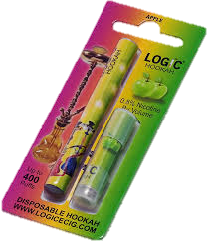
E-cigs (Battery-powered devices made to mimic the size and weight of combustible cigarettes)
Disposable (200-1800 puffs)
Rechargeable (wall, car and USB)
Flavored Cartridges
E-cigar/E-Hookah/E-Shisha

Slide 19
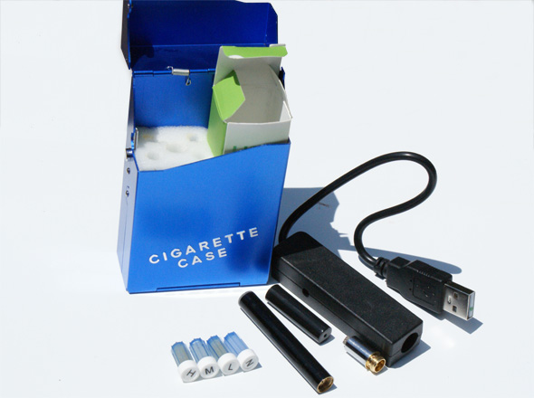

Slide 21
Vaporizers (Larger devices with higher-powered batteries that vaporize nicotine through an open or closed tank system)
E-liquids- Used in Vaporizers, solution that contains varying levels of nicotine
Mods- Large scale cylindrical or box shaped vaporizers housing extremely large batteries

Slide 22
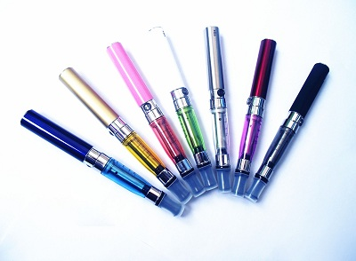
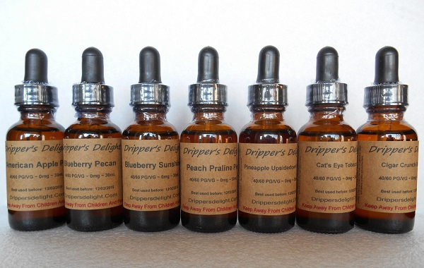

Slide 23
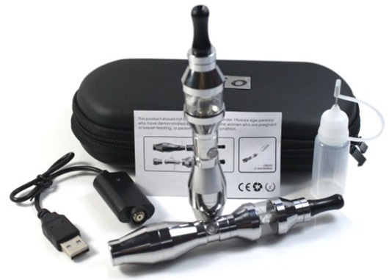

Slide 24
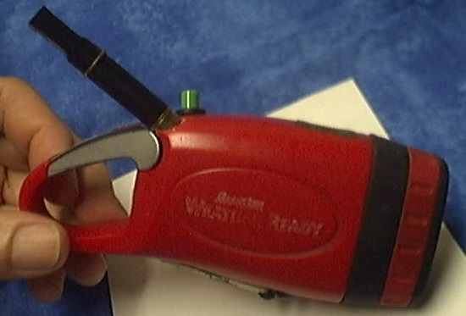

Slide 25
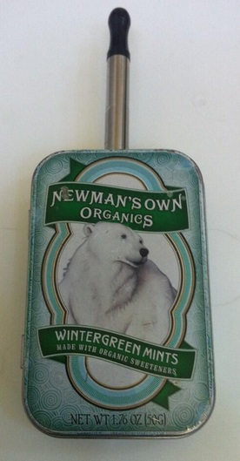
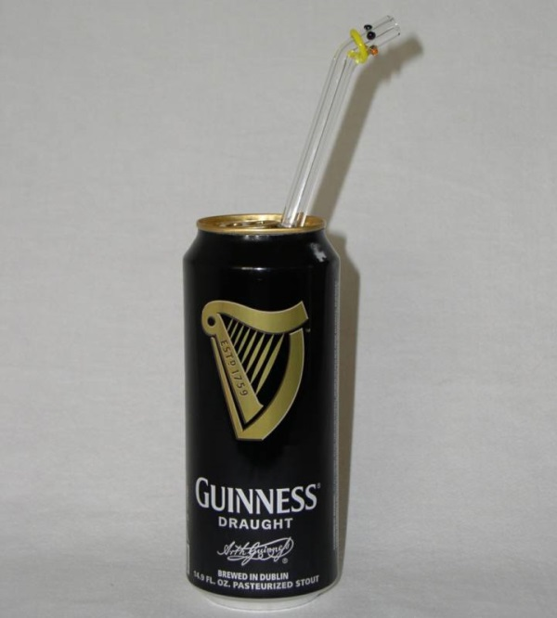

Slide 26
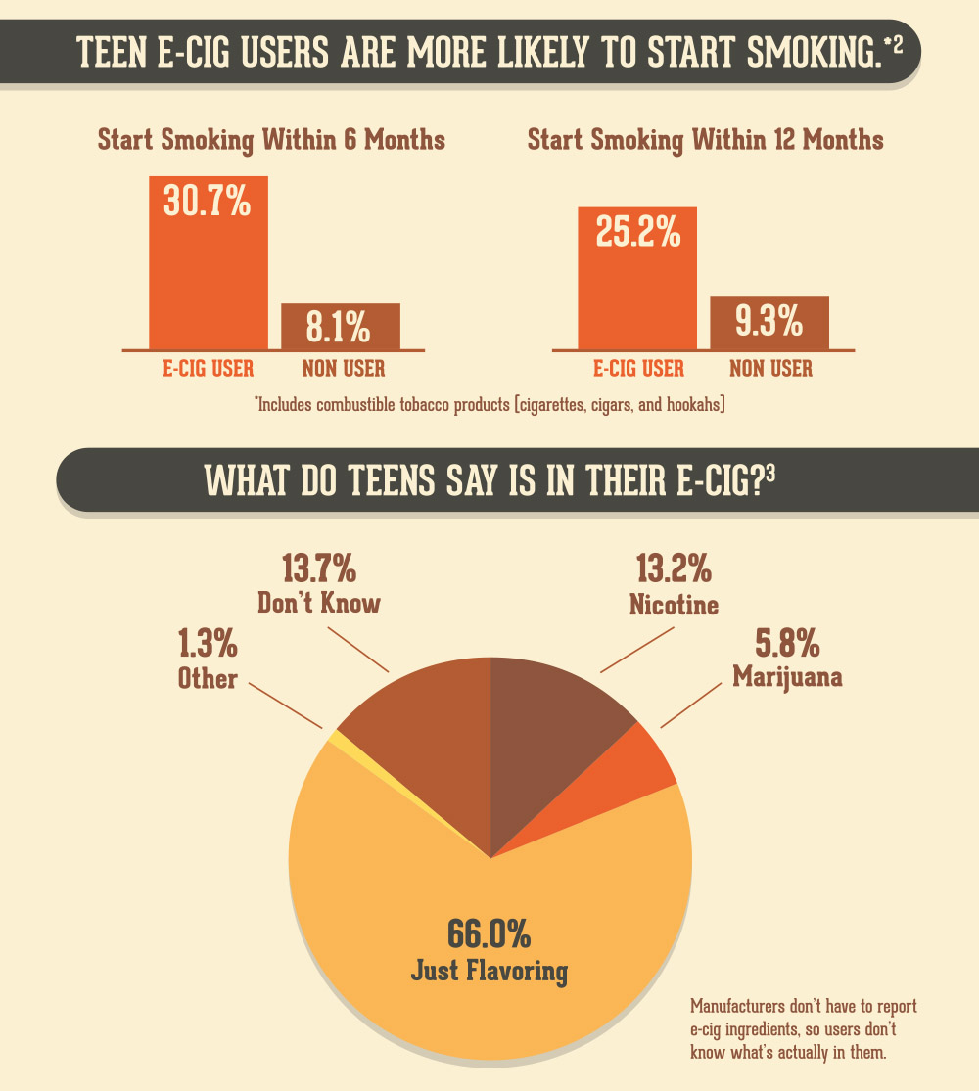

Slide 27
Heat-Not-Burn ( Products that heat actual tobacco vs liquid nicotine)
Dry Vaporizers- Devices that let consumers vaporize their own tobacco or other plant product
Pods- Similar to e-cigs but with actual tobacco instead of liquid nicotine

Slide 29
Popularity
Cheap
Highly available
Youth-appealing flavors, colors and designs
Products made to conceal use

Slide 30
Choose the Albuterol Inhaler

Slide 33
FIVE Signs your Child is Vaping
The scent
“Pens” that aren’t pens
Copious sipping of Liquids
Nose Bleeds
Passing on Caffeine

Slide 34
Electronic Cigarettes Market Growth
From $500 Million in 2012, to $1.7 Billion in 2013.
Wells Fargo - sales will surpass conventional cigarettes in ten years.

