Slide 1
Nicotine and Tobacco to Age 21
Why?
Why Now?
Why Here?
Why Does It Work?
What is it?
*Date*

Slide 2
Primary & Secondhand
Smoke Kills A Half Million Americans Annually
Primary Smoking
All of
Vietnam
War
Opiates/Cocaine
All of
WW II
Second-
hand
Smoke
Auto
Crashes
Murders
Notes:
- We are first going to talk about the Why.
You can’t start talking about cigarettes without unfortunately talking about death.
Explain Graph – Smoking and Second hand smoke account for over a half a million deaths a year in the United States
That is the equivalent of 3 fully loaded 747’s crashing and burning every day at *mention local airport to personalize it*
If one plane crashed it would be in the news for months. But this is the reality of Tobacco use

Slide 3
Primary Smoking
All of
Vietnam
War
All of
WWII
Opiates/Cocaine
Second-
hand
Smoke
Auto
Crashes
Murders

Slide 4
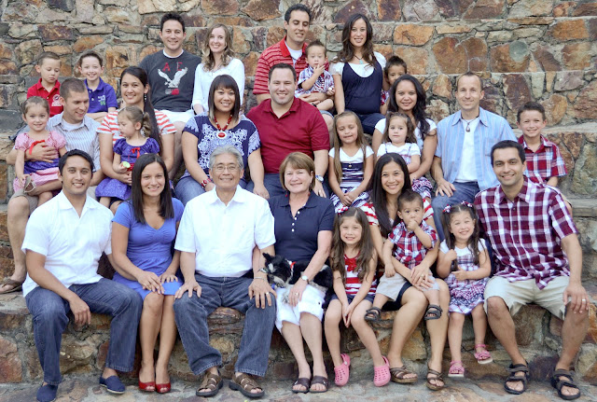
Notes:
Not only does it bring death, but it is the type of death that it brings, a slow, painful, asphyxiating death.
This slide will show just some of the ways tobacco can end a life

Slide 5
Breast Cancer
Cervical Cancer
Myocardial Infarction
Placental Abruption
Chronic Bronchitis
Stroke
S.I.D.S.
Acute Leukemia
Esophageal Cancer
Asthma
Bladder Cancer
Stillbirth
Emphysema
Prematurity
Alzheimers
Aortic Dissection
Miscarriage
Lung Cancer
Kidney Cancer
Lip/Tongue/Mouth Cancer

Slide 6
Disability
ICU
Bereavement
Loss
Dispair
Chemo
Funeral
Hospice
Surgery
Radiation
Death
Suffering
Pain
Depression
Emergency Room
Notes:
And it is not just death that Tobacco brings. If you look at this slide you will see how many negative affects tobacco has, not just for the user, but for those close to them.
I am sure some of you have your own stories about how Tobacco use has affected your life.
We have to do something different.

Slide 7
United State Surgeon General
Centers for Disease Control
Department of Health and Human Services
5.6 Million
Notes:
This video is from the CDC, detailing how, with our current trajectory, 5.6 million kids alive today will die from Tobacco use
We have done a good job against smoking, but we haven’t done nearly enough.

Slide 8
Published March 12, 2015
Notes:
Let’s now talk about the ‘Why Now?”
In 2009, as part of the Family Smoking Prevention and Tobacco Control Act, Congress mandated a study to be done by the Institute of Medicine research the effects of raising the tobacco age. It was just released in early 2015.
Unfortunately, thanks to big tobacco the FDA is prohibited from raising the tobacco age nationally, which shows you how afraid they are of this idea

Slide 9
4.2 Million Years of Lives Saved in Kids Currently Alive Today
25% Drop in Youth Initiation
12% Drop in Overall Smoking
12% Drop in Prematurity
16% Drop in SIDS
Notes:
Using mathematical modeling with extremely conservative estimates, here are some of the findings from the 360 page report.
*Read from slide*
Mention that there is reason to believe the drop in youth initiation would be closer to 50%
Young women smoke during pregnancy at a much higher rate than their older counterparts. These last two figures would have IMMEDIATE impact, and alone make this worth considering.

Slide 10
In the last two years over 130 cities in 10 states covering 20 million people have raised their minimum sales age to 21.
Hawaii passed in 2015 and California is poised to in 2016!
Notes:
Other reasons for why now? An average of one city a week passes a Tobacco 21 ordinance. The momentum behind this is huge.
Hawaii became the first state to raise their tobacco age to 21, which they began enforcing 1/1/2016
California has passed a Tobacco 21 bill through the House and Senate, and it simply awaits the governor’s signature.

Slide 11
What percent of Ohio HS
seniors who use tobacco
(30 day prevalence)?
27%
Does not measure
electronic cigarette
or hookah use.
Youth Risk Behavior Survey (YRBS) 2013
Notes:
Now lets talk about ‘Why *your city*’
Go to http://nccd.cdc.gov/youthonline/App/Default.aspx and find your state’s rate of current tobacco use among high school seniors. Seniors are the best predictor of adult tobacco use.
Mention how this doesn’t even measure hookah or e-cigarette use
Very discouraging number.

Slide 12
Early Nicotine Use Changes Brains
Adolescent smokers – First illicit drug – a gateway
3X more alcohol use
8X more marijuana use
22X more cocaine use
Higher dropout rates
More likely to experience teen pregnancy
The earlier a kid starts,
the heavier a smoker as an adult.
Notes:
Why is this high number so important?
Nicotine is the only substance that has a neurotransmitter receptor named after it.
It affects the deep, ancient parts of the brain that are probably shared with the dinosaurs. And since Adolescent brains are so susceptible to change, using nicotine at a young age can affect the brain in troubling, permanent ways.
Nicotine is the gateway drug, leads to *read slide*
Early users are also prone to more mental problems, more socioeconomic problems, and are less likely to ever quit smoking

Slide 13
Reproductive Outcomes
Female infertility
Low sperm count, motility, function
Reduced erectile function
Miscarriage
Ectopic Pregnancy
Placental Abruption/Accretion
Placental Previa
Low birth weight
Prematurity
Stillbirth
SIDS
Poor Lung Development
Behavior Changes
Smoking in pregnancy doubles infant mortality
Notes:
One of the things the Institute of Medicine report investigated was the affects on infant mortality.
Here are some of the complications in pregnancy due to smoking.
Just a reminder that smoking during pregnancy doubles infant mortality rates.

Slide 14
Franklin County Infant Mortality Crisis
Our infant mortality is 50% higher than the rest of the U.S
Mortality for black babies is 2.5 times that of white babies
Our pregnancy smoking rate is twice the national average
Franklin County women ages 18-21 smoke at twice the rate of their older counterparts
Notes:
This is a slide you may or may not use, depending on your city’s infant mortality rate. email tom.geist@tobacco21.org if you need help finding infant mortality information for your area

Slide 15
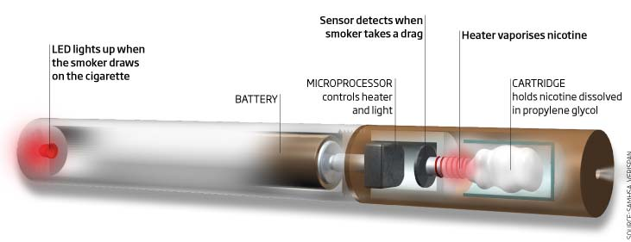
Notes:
This slide is on everyone’s lips now, especially if you are a kid.
We had been doing a decent job bringing down adolescent smoking. There was a steady decline over the last 15 years.
All of a sudden, however, the National Youth Tobacco Survey has reported that for the first time in decades tobacco use among youth has risen over the last year
And it is all thanks to this, the e-cigarette, along with hookah, and small cigars, has brought nicotine addiction back to the forefront of attention because it is new, kids think it is safe, and they think it is cool.

Slide 16
Methadone
Methadone offers heroin users a less harmful addiction,with fewer antisocial effects. E-cigarettes may function similarly for nicotine addicted adults.
But should our kids
be aggressively marketed and sold
this form of methadone?
Notes:
Some people say that you can quit smoking using an e-cigarette, and move from combustible cigarettes to a less harmful products. The jury is still out on whether that is true, and what the health effects of e-cigarettes are.
If true, e-cigarettes would function like methadone, in that they can may offer an alternative that is less harmful to themselves and others.
However, I think the question is, do you want this new form of methadone aggressively marketed to kids via sex appeal and candy flavors? I think we can all agree the answer is no.
It is not the tar and other stuff in tobacco that permanently changes the brain chemistry of children, it is the nicotine.

Slide 17
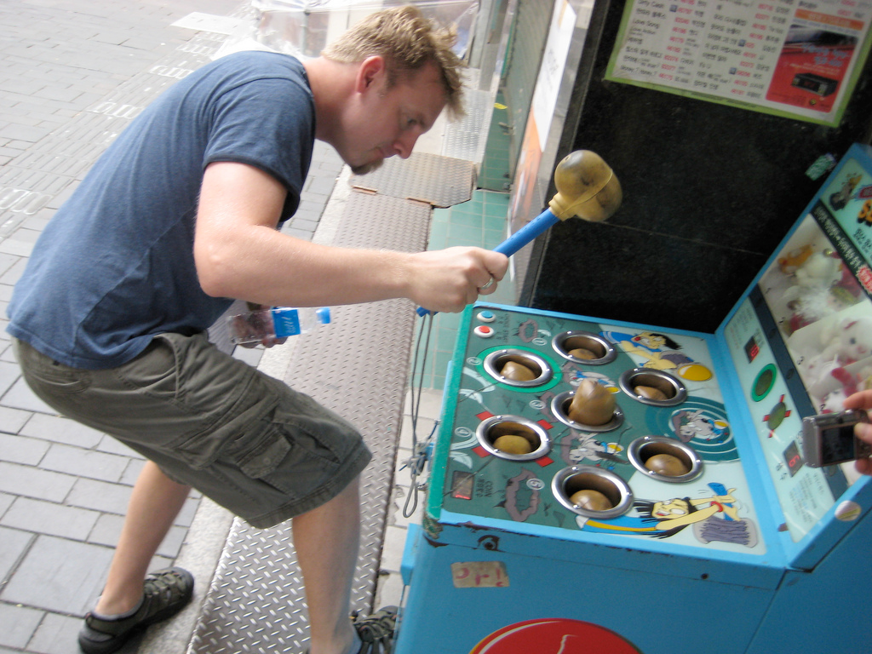
Notes:
Some people may be old enough to remember all the previous innovations the tobacco companies introduced to allegedly reduce the harm of cigarettes
First there was the micronite filter, which they said would remove all the bad stuff from your cigarettes
Then there was the low tar cigarette, which had all of the flavor without any of the bad stuff
Did they work no? In fact, they actually caused smokers to breath the smoke deeper into their lungs, potentially making them more harmful.
Now we have e-cigarettes, vaping, and hookah.
What am I saying? Every time we knock down a product of theirs, another pops right up. We need to try something new. We need to set a higher bar.

Slide 18
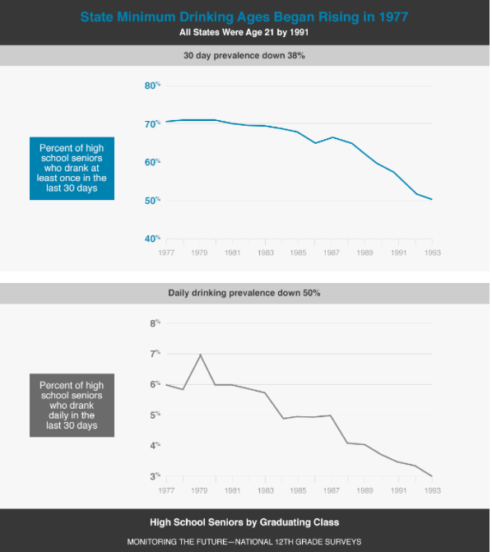
Notes:
- Now I would like to talk about another substance we have had trouble with, one with which the United States conducted a natural experiment
- After the Vietnam war the age to vote went down to 18. The alcohol industry then pushed to drinking age down to 18, reasoning that if you can vote you can drink.
What happened? A conflagration on the highways. 20,000 extra serious injuries on the highway every year. Between 1,000 to 1,500 extra deaths a year thanks to the lowered drinking age.
It was so obviously a bad idea that President Reagan and congress decided to twist the arm of each state by way of withholding funding in order to get them to raise the alcohol age back up to 21.
Here is what happened – look what happened to prevalence of drinking among high schoolers. The top graph is drinking once in the last 30 days, which went down from over 70% to below 50%
And daily drinking, which is much more like smoking, went down by two-thirds. And this cohort of people continued to drink less than previous generations as they aged, showing delaying initiation worked.

Slide 19
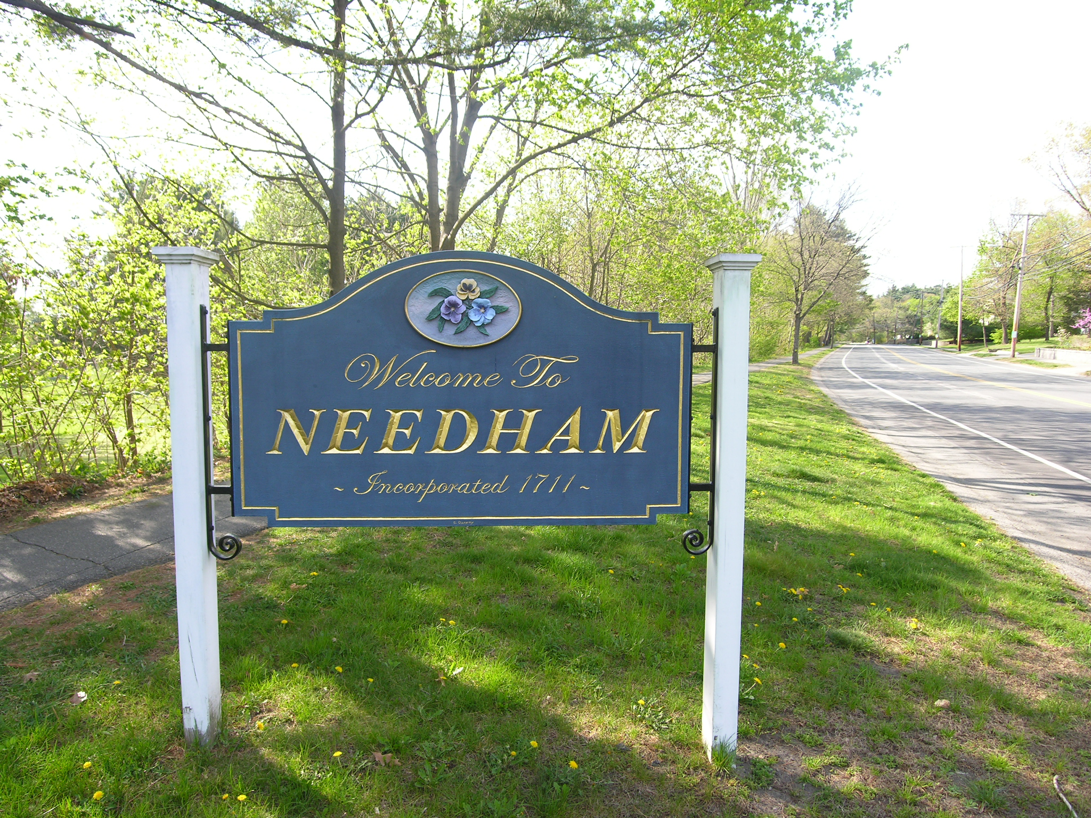
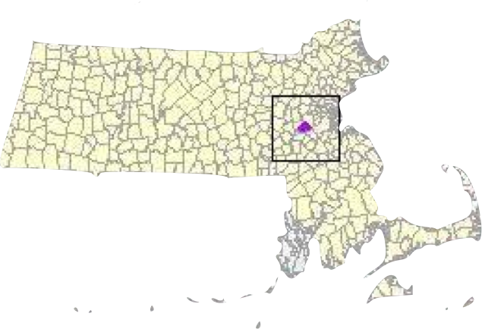
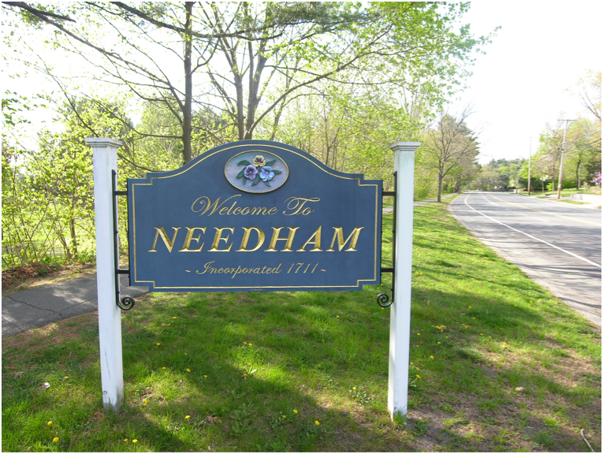
Notes:
This brings us to our exemplar, Needham Massachusetts.

Slide 20
Notes:
It is a town of 30,000 people, a suburb of Boston, that sits closely surrounded by 5 other suburbs

Slide 21
Needham, Massachusetts
2004 Health Board Acts
Grandfathering 2005-2008
Notes:
In 2004 they decided they were going to raise their Tobacco age to 21. They grandfathered in people already over 18 so it took three years to be in full effect.
It was thought that the other suburbs would follow suit, but none of them did. No one touched it, so it didn’t seem like it would have a great effect.

Slide 22
High School Smoking - Two Age Limits
Notes:
And yet, here is what happened. A study was done by a charitable foundation that measured smoking rates among high schoolers in the Metrowest area, which is a collection of over 20 suburbs near Boston.
Look at the difference in the drop in youth smoking between Needham and the other suburbs. Needham dropped its current smoking rate, which is once in the past 30 days, by 50%. It dropped its frequent smoking by 65%. Now, the other suburbs did drop as well, but Needham dropped by 3 times the rate.
This is the data that NYC and Mayor Bloomberg looked at to decide to take their tobacco age to 21. This is the data that shows that this will work, and work even when you are in a city tightly surrounded by other suburbs. One where you can drive 10 minutes down the road to the next town.
Why did it work? Because it marked a cultural change, and because of this…

Slide 23
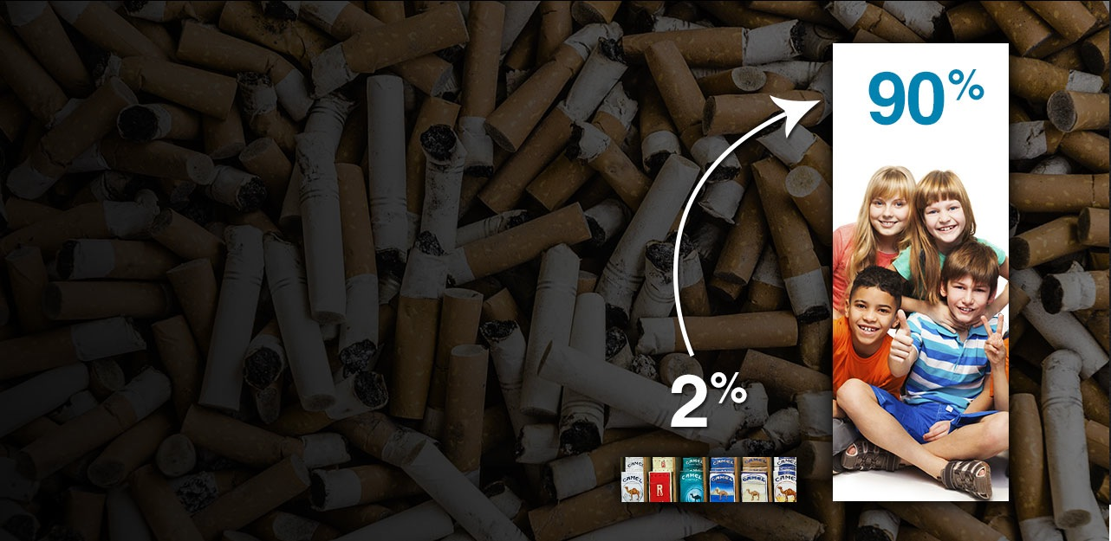
18–20 year olds purchase only 2%
of cigarettes sold, but are 90% of the supply of addictive tobacco to younger kids.
Notes:
Almost all of those who supply tobacco products to those under 18, are themselves under 21.
High school kids just don’t know many people over 21, and those who are over 21 are much less willing to buy a high school kid cigarettes every day.
However, those who are age 18-20 purchase only 2% of all cigarettes sold, a small sliver.
This is the lever by which tobacco 21 works. By eliminating only 2% of sales, nowhere near enough to take a local business under, almost 90% of initiation can be eliminated.
That 2% of the market drives almost all addiction.

Slide 24
Important Legislative Features
Strong preamble.
Comprehensive definitions of e-cigarettes, other smoking devices and ingestible forms.
Focus on sales not purchase.
Penalties that will encourage compliance.
Notes:
Here is the what. What we think is important for a strong piece of legislation to effectively implement a tobacco 21 ordinance.
There are examples of strong tobacco 21 ordinances you can find online at tobacco21.org
It is time for you to help children keep away from tobacco products, and end this epidemic.

Slide 25
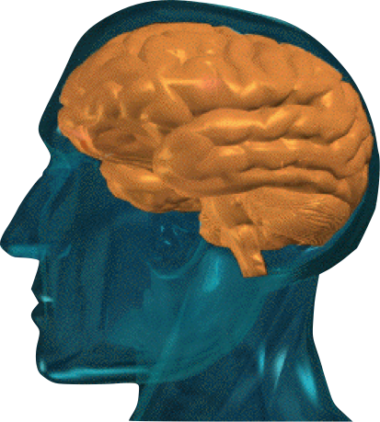
Notes:
- I like to end by remembering that a human brain turned on its side looks like a question mark…

Slide 26
Notes:
- Any questions?

Slide 27
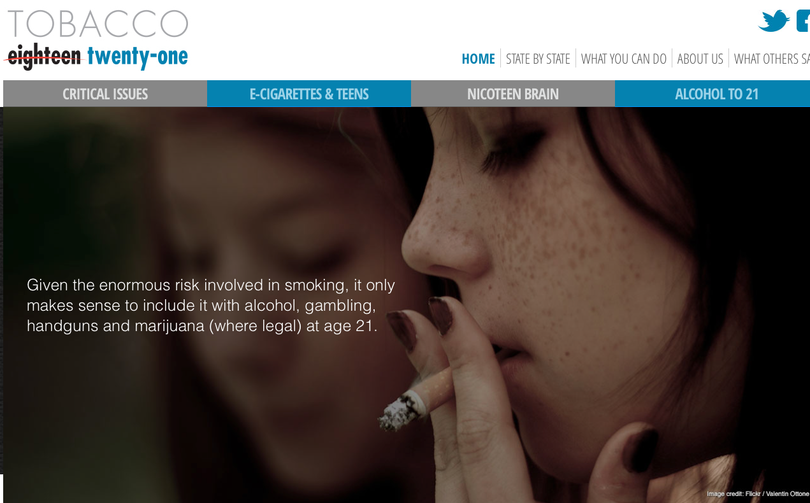
Notes:
Direct audience to visit Tobacco21.org for more information. Visit the about us to ask us any questions
One final thought to end on (next slide). Never end on questions, end with a finale (video on next slide)

Slide 28
Notes:
One final thought to end on. Never end on questions, end with a finale (this video)

