Slide 1
Drafting Your Policy
Kristen Tertzakian
April 7, 2018
Notes:
I’d like to get a sense of where you are in the policy process.
How many have had a taskforce meeting?
How many have a draft policy?

Slide 2
100% smoke or tobacco-free policy
100% Smoke-free = Smoking is prohibited everywhere on campus, indoors and out, at all times.
100% Tobacco-free = Use of all tobacco products, including non-combustibles, is prohibited everywhere on campus, indoors and out, at all times.
Notes:
What do we mean by 100% smoke-free and tobacco-free policies
A 100% smoke-free policy prohibits the use of smoke-producing tobacco on all property that is owned, rented or leased by the college including all indoor and outdoor areas like parking lots, atheltic facilities, and vehicles. Designated smoking areas on campus are prohibited. We’re not just talking about cigarettes – but any product that produces smoke including cigars, cigarillos, small cigars, pipes, and hookah.
A 100% tobacco-free policy is more expansive – this include any tobacco product - smokeless tobacco
We recommend that a strong policy should include e-cigarettes. The policy must be college-wide, affecting all campuses.
For a more complete definition, please refer back to the grant guidelines. We include a link to model campus policies from Americans for Non-Smokers Rights.

Slide 3
Growing momentum
2,164 campus sites are 100% smoke or tobacco-free
1,805 are 100% tobacco-free
1,741 also prohibit e-cigarette use
883 also prohibit hookah use
278 also prohibit smoking/vaping marijuana
Notes:
Source: https://no-smoke.org/at-risk-places/colleges/

Slide 4
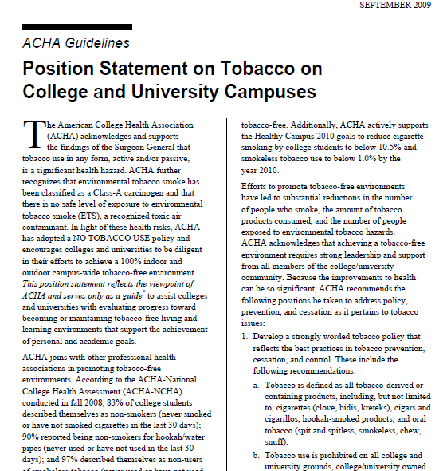
Leaders in the health field
American College Health Association
U.S. Department of Health and Human Services
Truth Initiative grant
American Cancer Society grant

Slide 5
Model policies
Available on Basecamp
Model Policy for a Smoke-Free College/University
http://no-smoke.org/pdf/modeluniversitypolicy.pdf
Model Policy for a Tobacco-Free College/University
http://no-smoke.org/pdf/modeluniversitytobaccofreepolicy.pdf
Start with clean model policy language
Notes:
Two models on web:
Model Policy for a Smokefree College/University: http://no-smoke.org/pdf/modeluniversitypolicy.pdf; OR
Model Policy for a Tobacco-Free College/University: http://no-smoke.org/pdf/modeluniversitytobaccofreepolicy.pdf
Start with clean model policy language
Do not copy another school’s policy

Slide 6
Policy Formation Process
Let the campus community know that the process is starting
- Start a webpage and include quit smoking resources
- Continually update on progress
Surveys as a means of communication
Make sure union or bargaining unit representative are part of the conversation from the beginning.
Communicate with neighbors
Notes:
What are ways you typically inform the campus about new initiatives?
(Open forums or town halls – newspaper – webpage)
Do more listening in the beginning than talking
Communicate to the neighbors that you are want them to be a part of the process and that you care about their concerns.

Slide 7
Do’s
WHY did the college adopt the policy?
WHEN does the policy take effect?
WHAT tobacco products does it include?
WHERE does the policy apply?
TO WHOM does the policy apply?
HOW will it be enforced and WHO is responsible?
Notes:
Here are some items to be included in your policy. Like a checklist. Your taskforce can discuss and make final recommendations on each.
WHY - Include the rationale – whys is your college going smoke or tobacco-free?
to promote a culture of health and wellness? Clean environment? Respect for all campus member
WHEN – realistic implementation date
WHAT - Be clear where tobacco cannot be used
WHERE - Example: Tobacco use is prohibited on all property owned, leased or rented by the college.
Who does it apply – visitors too. Just a note about signage. Contractors too (in all contract language)

Slide 8
Example: Reedley College, California
Reedley College is a smoke and tobacco free campus effective November 17, 2016. This action confirms our commitment to creating a clean and safe learning environment for students, staff, volunteers and visitors.
Use of all tobacco products, including cigarettes, cigars, pipes, all forms of smokeless tobacco, and electronic cigarettes are prohibited in all property owned or controlled by Reedley College.

Slide 9
Reedley College (cont)
This includes: grounds and buildings, athletic areas, college vehicles, college rented vehicles, carts, parking lots and farm land.
The policy also applies to Madera Community College Center and Oakhurst Community College Center.

Slide 10
Community College of Allegheny County
To promote the health, well-being and safety of all students, faculty, staff and visitors, the College prohibits the use of smoke and tobacco products in or on College property.
This Policy applies to all persons on College property, including but not limited to faculty, staff, credit students, non-credit students, guests, contractors, subcontractors, vendors, visitors, volunteers and contractors working on construction projects on College property.
Notes:
Rationale
Who it applies to

Slide 11
Community College of Allegheny County
The College will not accept donations, gifts, money or materials intended to promote the use of smoke and tobacco products, and will not participate in any activity that promotes the use of smoke or tobacco products. The sale of smoke and tobacco products or related merchandise on College property is further prohibited.
Notes:
Sponsorships and sale of tobacco

Slide 12
Community College of Allegheny County
For purposes of this Policy, “smoke and tobacco products” include, but are not limited to, cigarettes, cigars, pipes, hookahs, smokeless tobacco, chewing tobacco, dip, snuff, electronic cigarettes, vaping devices and any other product packaged for smoking, the simulation of smoking or that may be considered to provide a gateway to smoking or tobacco use.
Notes:
Define the products

Slide 13
Community College of Allegheny County
“College property” means all property owned by, leased or under the control of the College, including but not limited to all grounds, parking lots, sidewalks, classrooms, academic and administrative buildings, restrooms, stairwells, facilities and theaters, and all vehicles leased, rented, owned, or under the control of the College or which are parked on College property.
Notes:
Define the property

Slide 14
Community College of Allegheny County
The College will develop and maintain regulations and procedures to implement the requirements of this Policy. These regulations and procedures will include information about smoking cessation programs and resources that may be available to students and employees through the College or in the community, compliance and enforcement monitoring activities, and imposition of appropriate sanctions for individuals who are found to have violated this Policy.

Slide 15
Acceptable exemptions
Smoking or using tobacco inside one’s own vehicle
Research in a controlled laboratory setting
Fundamental traditional and ceremonial use of tobacco by Native American tribal members
*Many campus policies contain NO exemptions

Slide 16
Heartland Community College, Illinois
For Heartland Community College, "Tobacco Free" means HCC will be completely free from use of all tobacco products including any cigarettes, cigars, pipes, beedies, clove cigarettes and any other smoking product that appears to be a cigarette or electronic cigarette. This policy includes smokeless tobacco, dip, chew, snuff, snus, and any other non-FDA approved nicotine delivery device or product.
Tobacco use is prohibited in all facilities and vehicles owned or leased by Heartland Community College and is prohibited on all College property. This policy does not extend to personal motor vehicles. All tobacco products in use must be properly disposed of prior to entering any College property or exiting a personal vehicle. Littering the remains of tobacco products or any other related waste product on College property is further prohibited.

Slide 17
Don’ts
Unacceptable exemptions
Theatrical/Artistic
Vague Educational and/or Clinical
Vague “President’s Permission” Catch-All
Special Areas/Special Times (e.g. Sports Arenas, Special Events, Leased Properties)
System-Wide Policies Granting Satellites Discretion
Notes:
Theatrical production exemption: Actors simulate activities or actions (murder, sex, etc.); it’s their craft. Smoking is not a logical exception, regardless of whether or not representation of smoking is required by copyright. The key word is “representation.”
“Permission of the president” exemption: This exemption, which often allows smoking and/or tobacco use at events or venues at the president’s discretion, is too vague and subject to abuse. The policy must describe exactly which activities warrant the president’s permission to smoke so that the ANR Foundation is able to determine whether the policy meets one of the three allowable exemptions.
Broad/vague exemptions, such as “for educational purposes,” “for clinical purposes,” “for artistic purposes” or “for research-related purposes” (no controlled lab requirement), even when permission of the president is required. Exemptions must be narrowly tailored to avoid abuse/misrepresentation, and specifically defined so that ANRF is able to determine whether the policy meets one of the three allowable exemptions.
Sports arena and/or special event exemption: Many schools include all areas of campus, at all times. When an arena on campus is exempted, the school is not truly 100% smokefree.
Off-campus property exemptions, where the property is effectively an extension of campus, e.g. off-campus staff/student housing.
Smoking area exemption. Even one designated smoking area on campus, no matter how small and/or remote (e.g. a parking lot or outside of one residence hall). If you can smoke on campus, the campus is not truly 100% smokefree. It also can create confusion and lead to noncompliance and enforcement challenges.

Slide 18
Compliance

Slide 19
Enforcement: Two approaches
Social Normative Approach
Punitive Enforcement
Raise awareness about policy and tobacco treatment services
Often includes encouraging campus community members to approach violators
Enforcement through typical campus channels (e.g., Student Affairs)
Citations/fines issued by campus security/police
Notes:
One of the future webinars will focus on policy implementation and communication. I want to start planting the seed for this.
Little research has been done on policy implementation and what works
Pluses and minuses to both
For those who take the social norm approach, the main message is compliance with the policy is shared responsibility of all campus members. Some of our grantees have identify and train students and staff to approach violators. They may create scripts and videos and train a group of students and staff who are ambassadors to approach violators. They also conduct environmental scans
Fines – Range from $10 to $50. Some have graduated scales – 1st offense is $25, then goes up. Money goes back to the project or cessation.

Slide 20
Voluntary compliance
Shared responsibility of entire campus
Example from Bakersfield College
Each member of the College community, including, students, faculty, staff, and volunteers, is responsible for observing and adhering to the Tobacco-Free Environment Policy.
Notes:
Some of our grantees did not want the policy to be punitive. They spent a good deal of time educating the campus, building support and communicating the new policy.

Slide 21
Disciplinary
Progressive disciplinary actions
Oral warning (policy reminder card)
Written warning and/or reprimand
Employees: Meet with HR Director and supervisor
Students: Meet with Dean of Students
Online trainings (cessation or the policy)

Slide 22
Administrative fine
Range from $10 to $50 a violation
Requires involvement of campus police or security
Fines go back to college to support cessation or policy enforcement

Slide 23
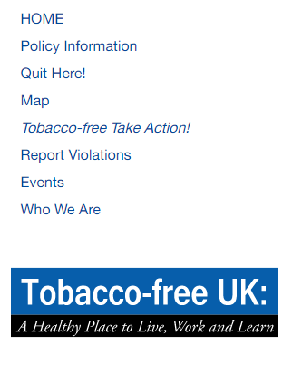
Example: University of Kentucky
Notes:
Not a grantee

Slide 24
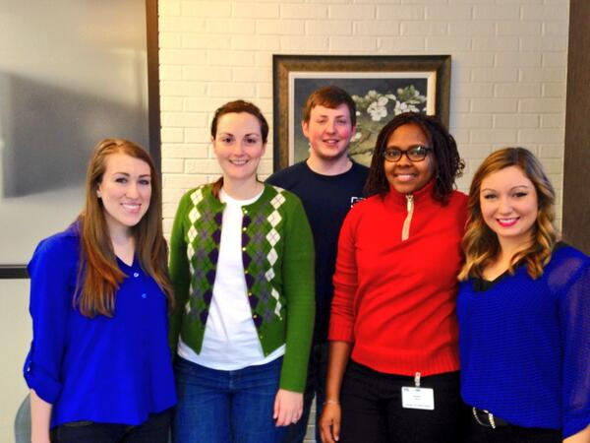
UKY: Student ambassadors
Student ambassadors are trained in:
Approaching violators
Using scripting techniques
How to respond if a violator refuses to comply
How to document and report violations
Environmental scanning
Cigarette butt data collection

Slide 25
UKY: Scripting example
Response: “Hello, my name is _____, and I am a(n) (state your title) at UK. Are you aware that our campus is tobacco-free? I ask you to please respect our campus and put your cigarette out (or other tobacco product) and dispose of it in a trash can.
Violator: “Okay” (puts it out)
Response: “Thank you. There are locations on campus that sell nicotine replacement products for a discounted price if you want to be comfortable while on campus. We also have low-cost ways of helping you quit when you are ready.” (Can also give them a TF information card)

Slide 26
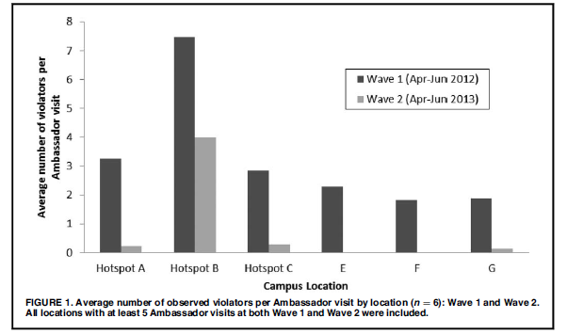

Slide 27
UKY: Scripting example
Students report to the Dean of Students
Subject to corrective action according to Student Code of Conduct
Employees report to supervisor, Human Resources Employee Relations
Subject to corrective action according to HR Policies & Procedures
Campus Visitors may be asked to leave campus
See www.uky.edu/Tobaccofree for more information
Notes:
II. C. Corrective Action

Slide 28
UKY: Reporting violations
Report violators of the tobacco-free policy to: ReportTFviolation@uky.edu
OR
submit via the online form on our website www.uky.edu/TobaccoFree

Slide 29
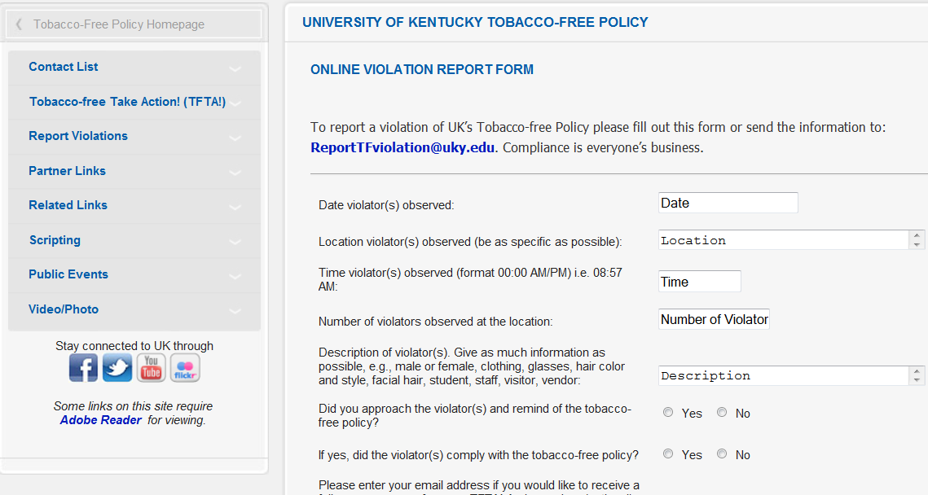
UKY: Online violation report form

Slide 30
Resources
The following resources were developed by Americans for Non-Smokers Rights:
List of 100% Smoke-Free and Tobacco-Free Colleges and Universities
List Criteria Tip Sheet
Model Policy for a Smoke-Free College/University
Model Policy for Tobacco-Free College/University
Available on Base Camp

Slide 31
More resources
Truth Initiative’s Implementation and Enforcement Guide
Available on Base Camp
Future webinars will focus on implementation and enforcement

Slide 32
Discussion questions
Where are you in the policy drafting process?
Who is involved drafting the policy?
What are you concerns?

Slide 33
Question and Answers

